Slide 1

Dissertation – Week 6
University of Oxford – OMMS
Kim López Güell

Slide 2
What I did last week
Started writing a little bit of the SR methodology
Switched to modeling. Basically finished all models for the most accurate data:
  All SR modeling in the UK
  All ARIMA modelling for cases and hospital admissions in the UK and Denmark
  Nicer plots for the UK, comparing to England
  Difference in differences modeling for the UK, comparing to England

Slide 3
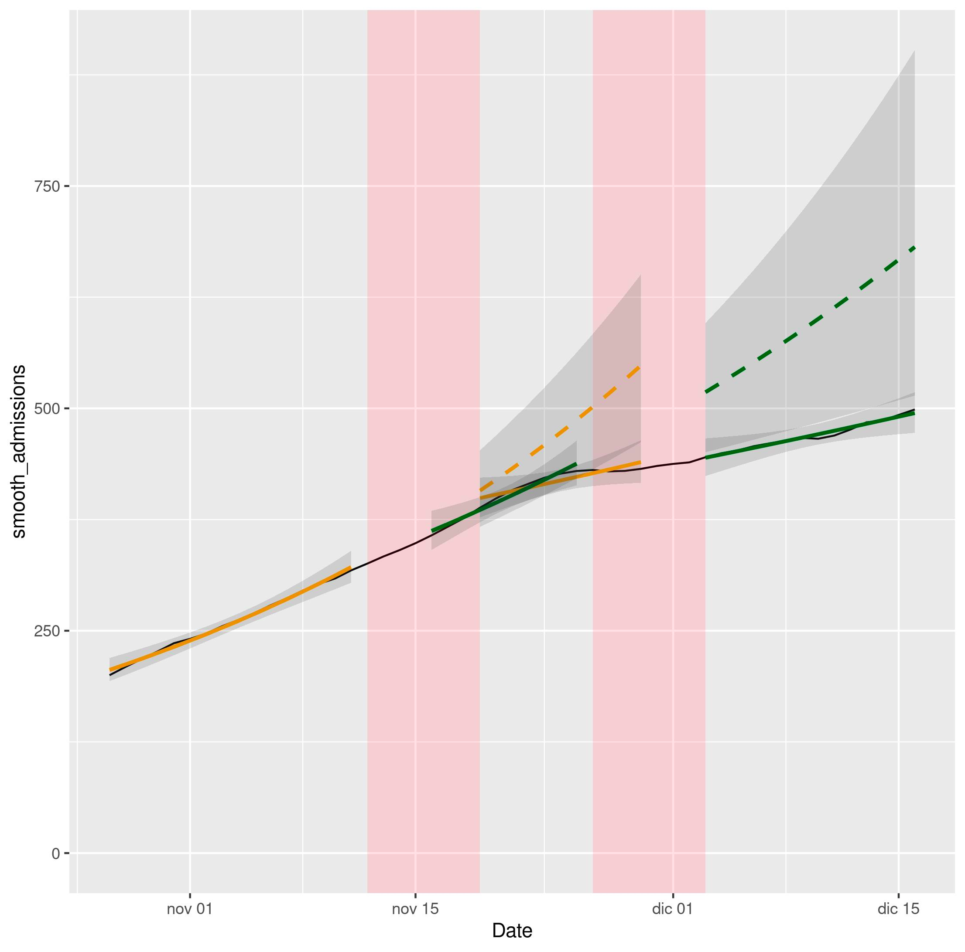
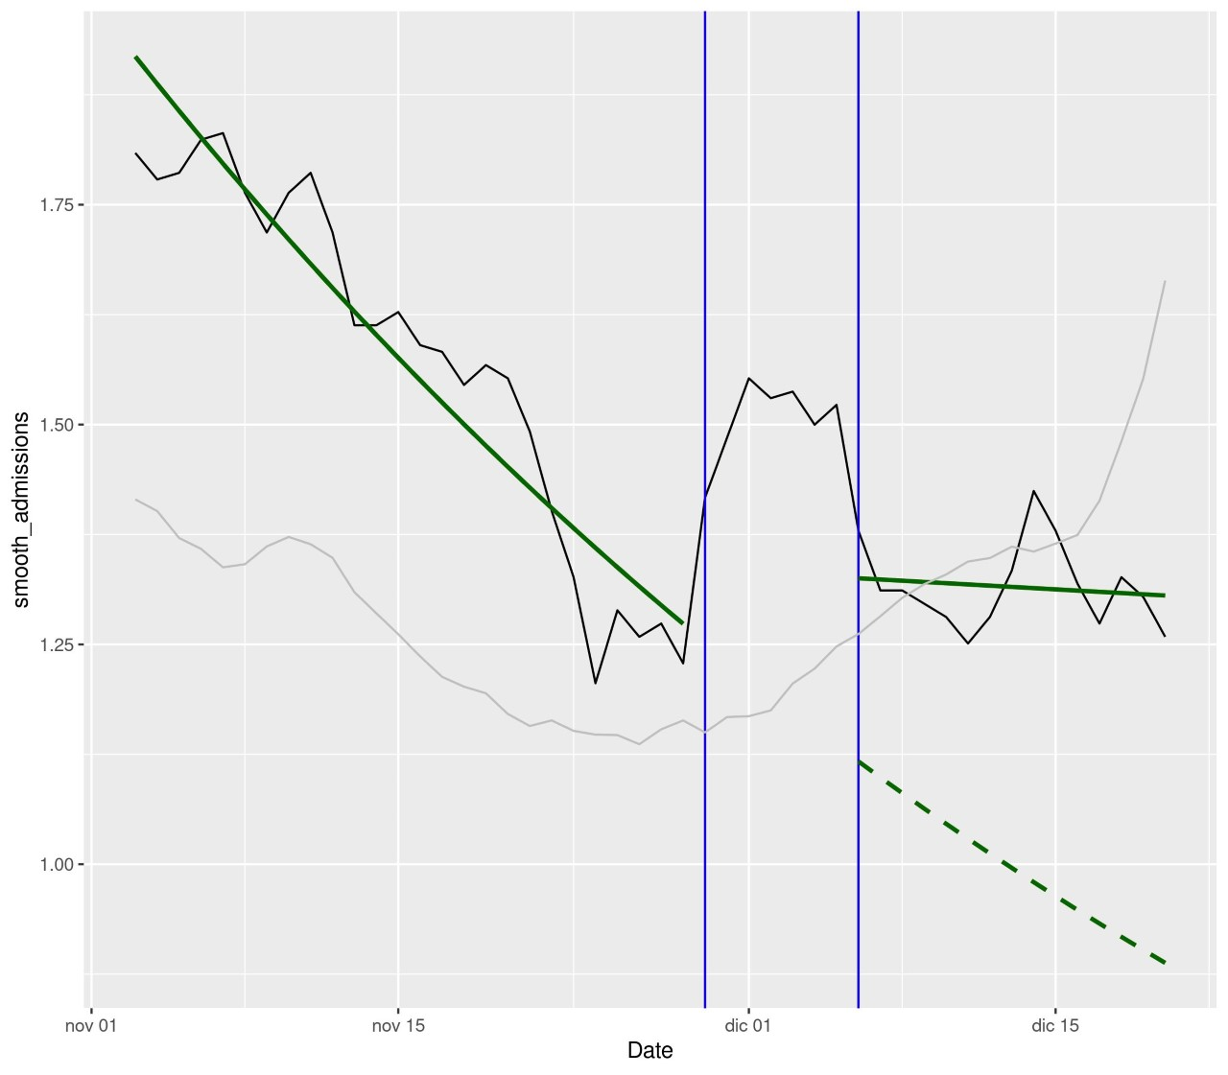
What I did last week
Example of SR plot (Dk, cases)
Example of comparison plot (NI, admissions)

Slide 4
What I will do next week
Finish all the plots with confidence intervals
Finish calculations of SE with bootstrap
Read similar published papers to know the required structure and start writing, in order:
  Tables and plots
  Results and discussion
  Methodology (from Research Proposal)
  Abstract
  Introduction

